Slide 1

TCS
Technical Round

Slide 2
Intro about the company
Tata Consultancy Services Limited (TCS) is an Indian multinational information technology (IT) service, consulting and business solutions company Headquartered in Mumbai, Maharashtra.
It is a subsidiary of the Tata Group and operates in 46 countries.
TCS is now placed among the ‘Big 4’ most valuable IT services brands worldwide.
TCS is one of the largest private sector employers in India, and the fourth-largest employer among listed Indian companies (after Indian Railways, Indian Army and India Post).

Slide 3
TCS Technical round
There are two components of technical questions. MCQ's and Programming.
MCQ (or) Fill in the blanks
20 Minutes
10 Questions
Coding round
20 Minutes
One C program

Slide 4
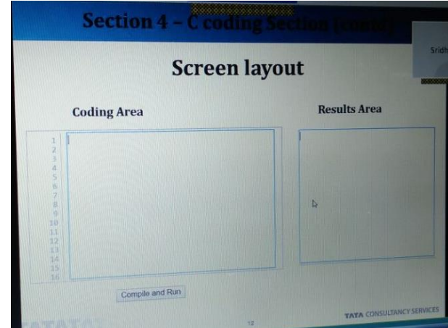
Coding platform

Slide 5
Coding platform - Instructions
There was only one question.
It has 10 attempts(We can compile only 10 times).
We must start our code from the scratch.
The coding platform is divided into two, one for writing the code and other for output. We should write the whole program.
We can't use any input functions like scanf(), getch(), getchar().
The input to be provided should be read as command line arguments.

Slide 6
Coding platform - Instructions
We must only print exact output.
Output must not be re-framed by extra words.
If there is any error, the error will be shown in the output dialog box.
The errors are clearly mentioned.
If there are no errors, a message like "compiled successfully" will be printed.
Along with that they will mention four test cases are 'passed' or 'failed'. They are indicated like private and public test cases. They have not mentioned what is the test case, which is difficult to understand.
There is no time limit. But, when all the 10 attempts are over, a message like "attempts exhausted" will be shown.
To compile and run there is a button provided. To run the code, just click on that.

Slide 7
1) How many times the below loop will be executed?
#include<stdio.h>
int main() {
int x, y;
for(x=5;x>=1;x--)
{
for(y=1;y<=x;y++)
printf("%d\n",y);
}
}
Notes:
Output:
1
2
3
4
5
1
2
3
4
1
2
3
1
2
1

Slide 8

Options
15
11
10
13

Slide 9
2) Where the local variables are stored?
Disk
Stack
Heap
13
Notes:
local variables can be stored either on the stack or in a data segment depending on whether they are auto or static. (if neither auto or static is explicitly specified, auto is assumed)

Slide 10
3) Select the missing statement?
#include<stdio.h>
long int fact(int n);
int main()
{
\\missing statement
}
long int fact(int n)
{
if(n>=1)
return n*fact(n-1);
else
return 1;
}

Slide 11
Options
printf(“%ll\n",fact(5));
printf("%u\n",fact(5));
printf("%d\n",fact(5));
printf("%ld\n",fact(5));

Slide 12
4) Which of the following indicate the end of the file?
Feof()
EOF
Both feof() and EOF
None of the mentioned
Notes:
EOF macro which expands to an integer constant expression, with type int and a negative value, that is returned by several functions to indicate end-of-file, that is, no more input from a stream.
The feof() function tests the end-of-file indicator for the stream pointed to by file pointer.

Slide 13
5) If a function’s return type is not explicitly defined then it’s default to ______ (In C).
int
float
void
Error
Notes:
If you do not specify a return type or parameter type, C will implicitly declare it as int.

Slide 14
6) For passing command line argument the main function should be like _______
int main(char *argv[], int argc)
int main(int argc)
int main(char *argv[])
int main( int argc, char *argv[])
Notes:
The full declaration of main looks like this:int main ( int argc, char *argv[] ) The integer, argc is the argument count. It is the number of arguments passed into the program from the command line, including the name of the program.

Slide 15
7) How many times the below loop will be executed?
#include<stdio.h>
int main()
{
int i;
for(i=0;i<5;i++)
{
printf("Hello\n");
}
}
Notes:
Output:
Hello
Hello
Hello
Hello
Hello

Slide 16
Options
5
1
0
3

Slide 17
8) Which of the following is a User-defined data type?
long int
double
unsigned long int
enum

Slide 18
9) Which has the highest precision?
float
double
unsigned long int
Long int

Slide 19
Floating point types
The following table provide the details of standard floating-point types with storage sizes and value ranges and their precision −
Type | Storage size | Value range | Precision
float | 4 byte | 1.2E-38 to 3.4E+38 | 6 decimal places
double | 8 byte | 2.3E-308 to 1.7E+308 | 15 decimal places
long double | 10 byte | 3.4E-4932 to 1.1E+4932 | 19 decimal places

Slide 20
10) What will be the output/error?(for input: 6, 9
#include<stdio.h>
int fg(int,int);
int main()
{
int n1,n2,g;
scanf("%d%d", &n1,&n2);
g=fg(n1,n2);
printf("%d",g);
}
int fg(int x,int y)
{
while(x!=y)
{
if(x>y)
return fg(x-y,y);
else
return fg(x,y-x);
}
return x;
}

Slide 21
Options
3
6
9
Error

Slide 22
Tips to Crack Test
Never guess an answer
Attend only the questions you are reasonably certain of answering correctly
If you don’t get the answer in the first try then skip the question
Read the question fully once and find out what they are asking
Try not to panic at the sight of those long programming questions.
Most programming questions are very simple which require you to do some logical thinking with a clear mind.

